Slide 1
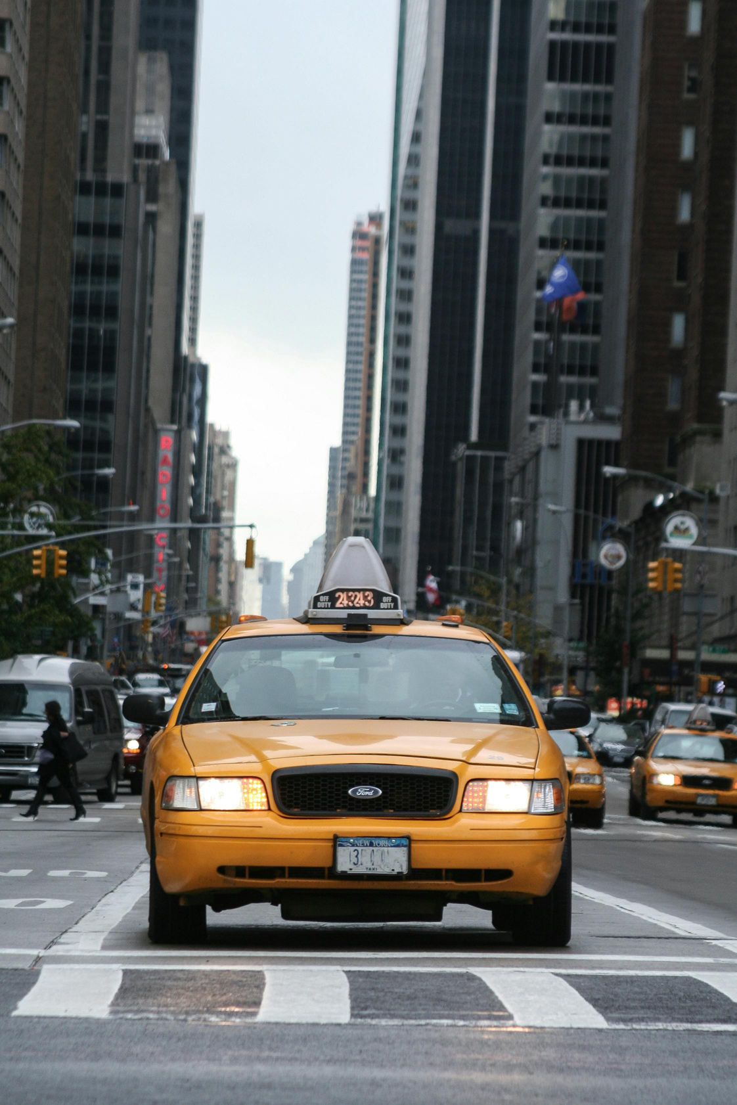
MAXIMAZING
REVENUE FOR
DRIVERS
THROUGH PAYMENT TYPE

Slide 2
AGENDA
Problem Statement
Analysis and Findings
Research Question
Hypothesis Testing
Data Overview
Recommendation
Methodology

Slide 3

PROBLEM STATEMEMT
In the fast-paced taxi booking sector, making the most of revenue is essential for long-term success and driver happiness.
Our goal is to use data-driven insights to maximise revenue streams for taxi drivers in order to meet this need.
Our research aims to determine whether payment methods have an impact on fare pricing by focusing on the relationship between payment type and fare amount.

Slide 4

Is there a relationship between total fare amount and payment type?
RESEARCH QUESTION
Can we nudge customers towards payment methods that generate higher revenue for drivers,
without negatively impacting customer experience?

Slide 5
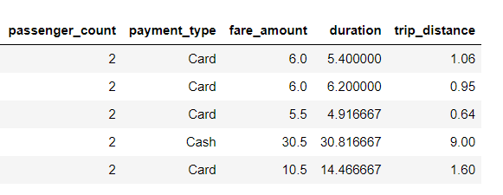
DATA OVERVIEW
For this analysis, we utilized the comprehensive dataset of NYC Taxi Trip records, used data
cleaning and feature engineering procedures to concentrate solely on the relevant columns essential for our investigation.
Relevent Columns Used
For The Research :
passenger_count
payment_type
fare_amount
duration
trip_distance

Slide 6
METHODOLOGY
Step | Description
Descriptive Analysis | Performed statistical analysis to summarize key aspects of the data, focusing on fareamounts and payment types.
Hypothesis Testing | Conducted a T-test to evaluate the relationship between payment type and fare amount, testing the hypothesis that different payment methods influence fare amounts.
Regression Testing | Implemented linear regression to explore the relation (calculated from pickup and dropoff times).

Slide 7
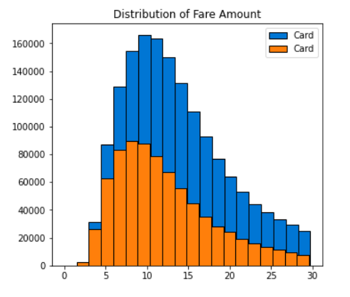
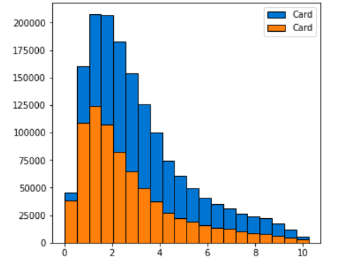
JOURNEY INSIGHTS
Customers paying with cards tend to have a slightly higher average trip distance and fare amount compared to those paying with cash.
Indicates that customers prefers to pay more with cards when they have high rare amount and long trip distance.
Distribution of Fare Distance
Distribution of Trip Distance

Slide 8
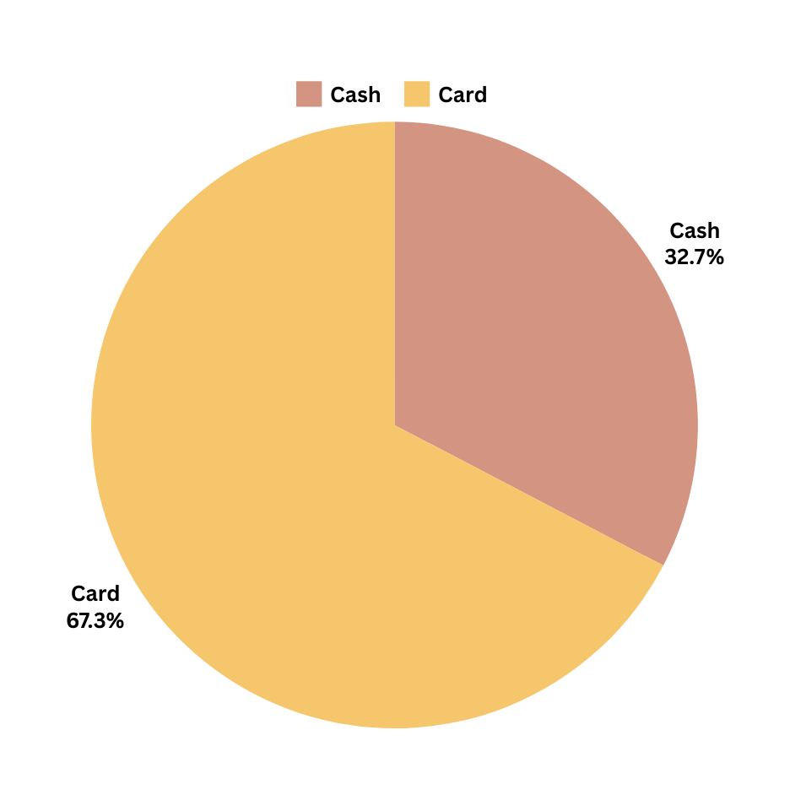
PREFERANCE OF PAYMENT TYPE
The proportion of customers paying with cards is significantly higher than those paying with cash, with card payments accounting for 67.5% of all transactions compared to cash payments at 32.5%.
This indicates a strong preference among customers for using card payments over cash, potentially due to convenience, security, or incentives offered for card transactions.

Slide 9
PASSENGER COUNT ANALYSIS
Among card payments, rides with a single passenger (passenger_count = I) comprise the largest proportion, constituting 40.08% of all card transactions.
Similarly, cash payments are predominantly associated with single-passenger rides, making up 20.04% of all cash transactions.
There is a noticeable decrease in the percentage Of transactions as the passenger count increases, suggesting that larger groups are less likely to use taxis or may opt for alternative payment methods.
These insights emphasize the importance of considering both payment method and passenger count when analyzing transaction data, as they provide valuable insights into customer behavior and preferences.

Slide 10
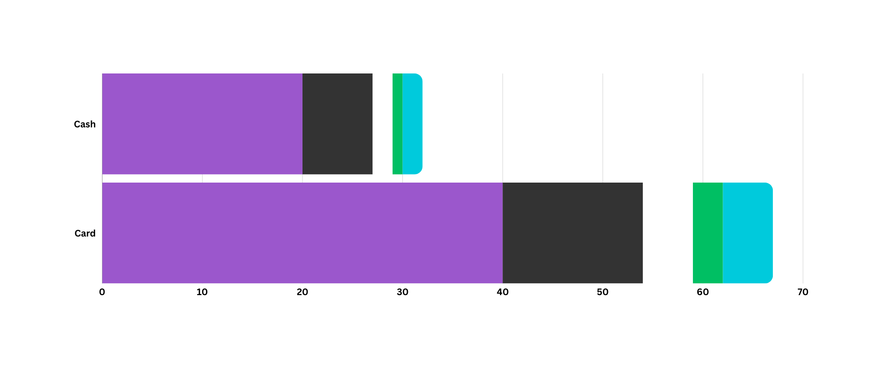
PASSENGER COUNT ANALYSIS

Slide 11

HYPOTHESIS TESTING
Null hypothesis: There is no difference in average fare between customers who use credit cards and customers who use cash.
Alternative hypothesis: There is a difference in average fare between customers who use credit
cards and customers who use cash
With a T-statistic of 164.9 and a P-value of less than 0.05, we reject the null hypothesis, suggested that there is indeed a significant difference in average fare between and trip distance.

Slide 12

RECOMMENDATION
Encourage customers to pay with credit cards to capitalize on the potential for generating more revenue for taxi cab drivers.
Implement strategies such as offering incentives or discounts for credit card transactions eo incentivize customers to choose this payment method.
Provide seamless and secure credit card payment options to enhance customer convenience and encourage adoption of this preferred payment method.

Slide 13


